Slide 1

NETFLIX MOVIES DATA ANALYSIS IN SQL

Slide 2
Netflix movie data analysis in SQL involves using SQL queries to explore and analyze data related to movies available on the Netflix platform. Netflix Movie Data Analysis Using SQL :- 1. Descriptive Statistics:- Descriptive statistics provide a summary of the dataset, giving insights into its main characteristics. 2. Grouping and Aggregation:- Grouping and aggregation help in summarizing data based on certain criteria. 3. Filtering Data:- Filtering allows you to extract subsets of data that meet certain conditions. 4. Joining Data:- Joining allows you to combine data from multiple tables based on a related column. 5. Trend Analysis:- Trend analysis helps in understanding patterns over time. 6. Complex Queries:- Complex queries combine multiple operations to extract deeper insights. By using these SQL queries, you can perform a comprehensive analysis of Netflix movie data, uncovering valuable insights and trends.

Slide 3

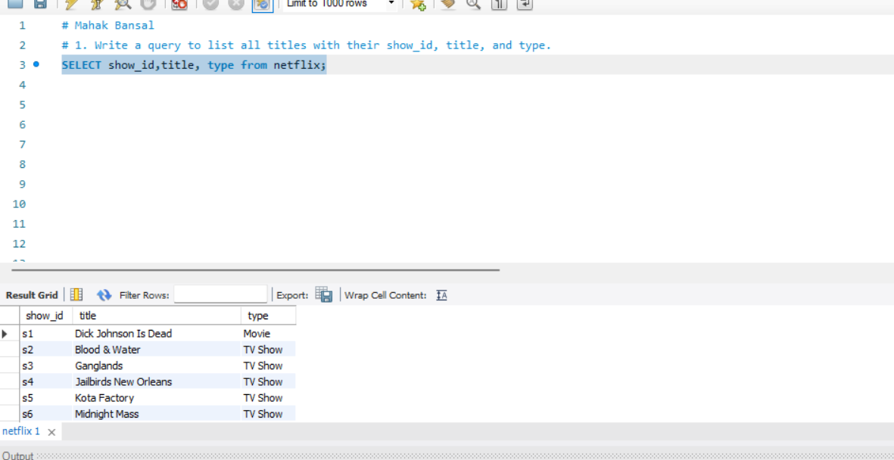
1. Write a query to list all titles with their show_id, title, and type. Query- SELECT show_id,title, type from netflix;

Slide 4
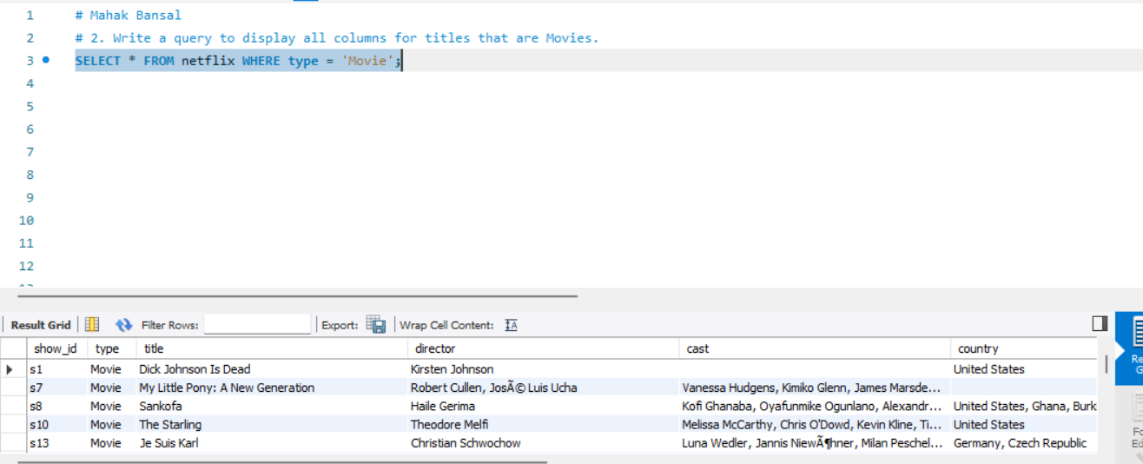
2. Write a query to display all columns for titles that are Movies. Query – SELECT * FROM netflix WHERE type = 'Movie';

Slide 5
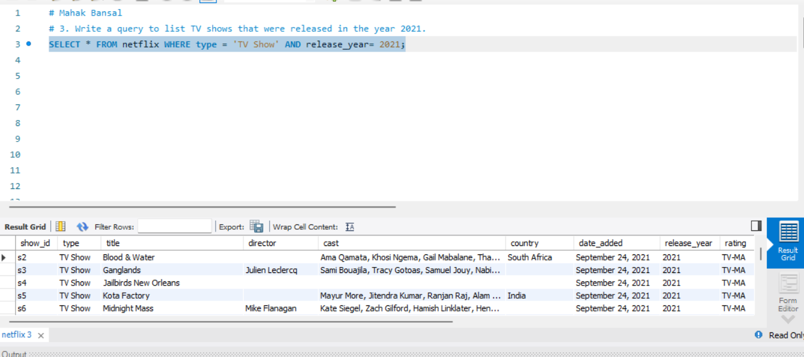
3. Write a query to list TV shows that were released in the year 2021. Query – SELECT * FROM netflix WHERE type = 'TV Show' AND release_year= 2021;

Slide 6
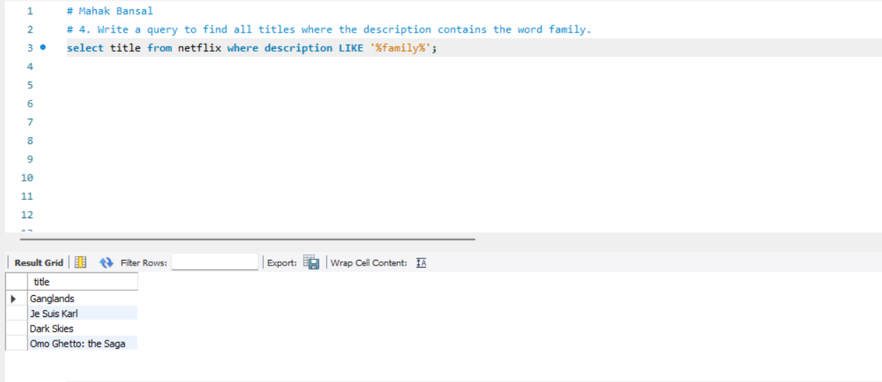
4. Write a query to find all titles where the description contains the word family. Query – select title from netflix where description LIKE '%family%';

Slide 7
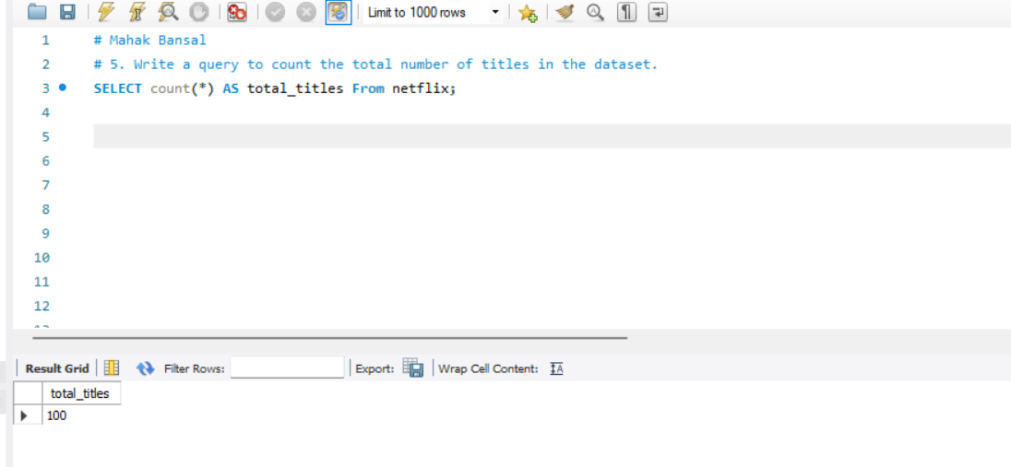
5. Write a query to count the total number of titles in the dataset. Query – SELECT count(*) AS total_titles From netflix;

Slide 8
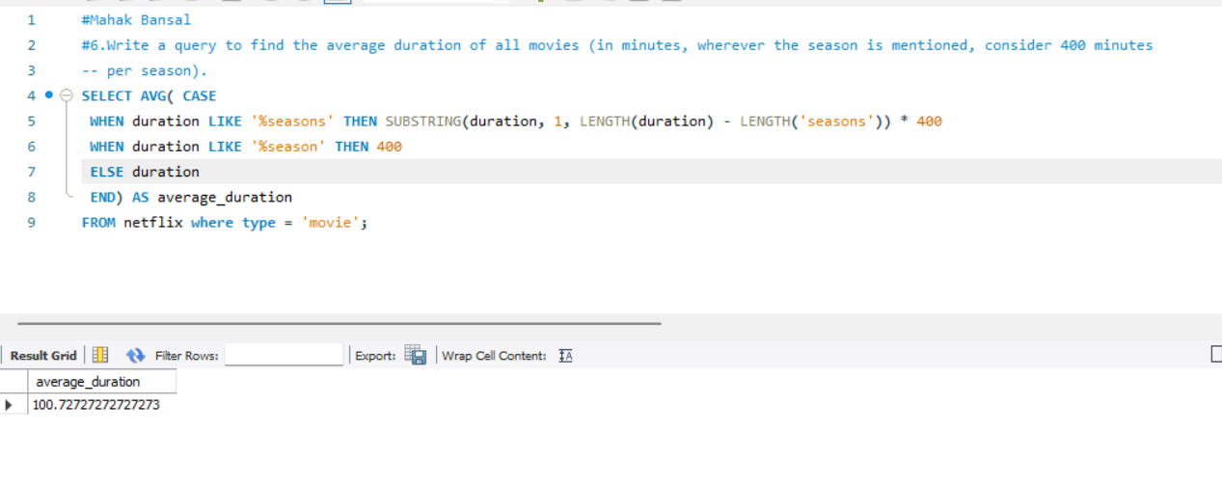
6.Write a query to find the average duration of all movies (in minutes, wherever the season is mentioned, consider 400 minutes per season). Query – SELECT AVG( CASE WHEN duration LIKE '%seasons' THEN SUBSTRING(duration, 1, LENGTH(duration) - LENGTH('seasons')) * 400 WHEN duration LIKE '%season' THEN 400 ELSE duration END) AS average_durationFROM netflix where type = 'movie';

Slide 9
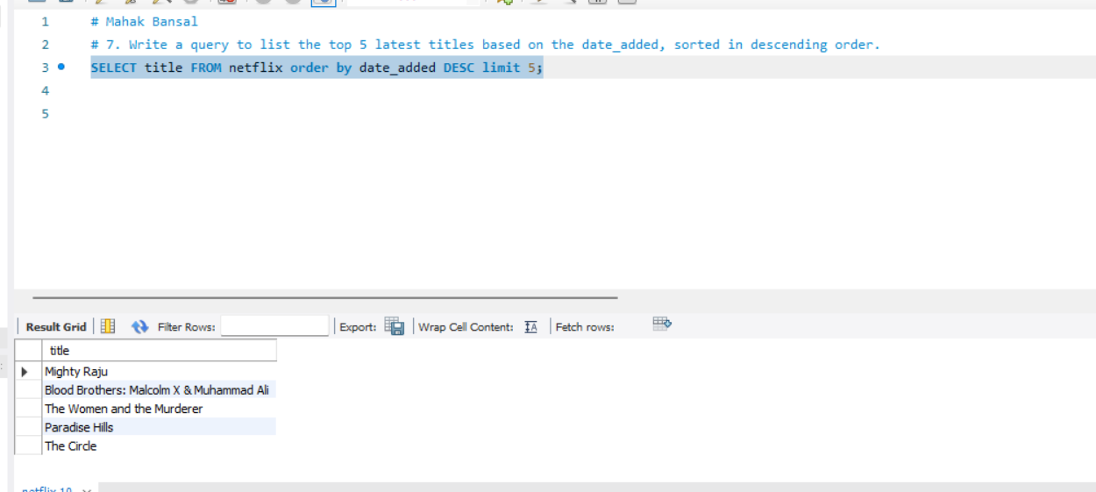
7. Write a query to list the top 5 latest titles based on the date_added, sorted in descending order. Query – SELECT title FROM netflix order by date_added DESC limit 5;

Slide 10
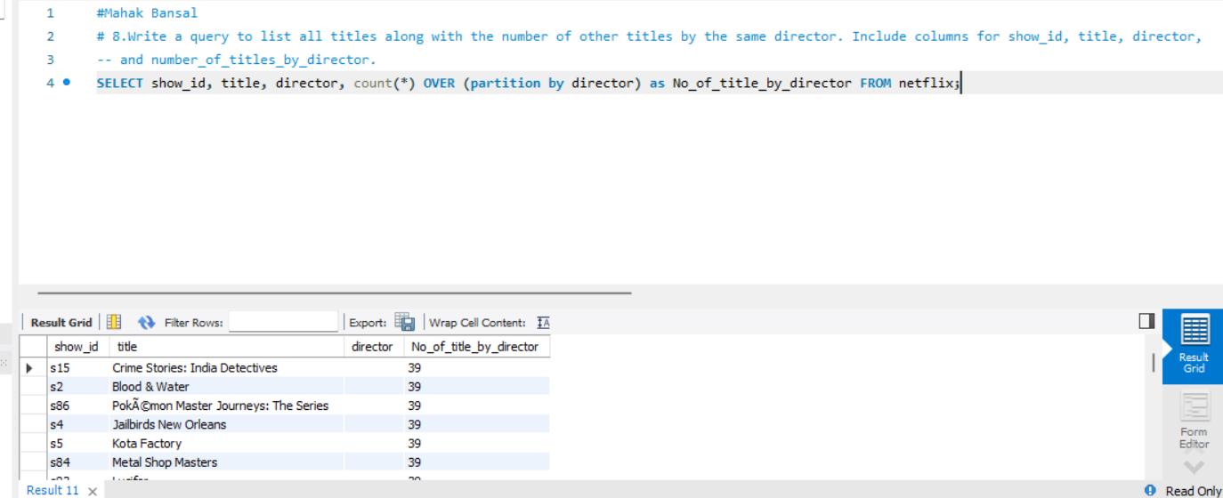
8. Write a query to list all titles along with the number of other titles by the same director. Include columns for show_id, title, director, and number_of_titles_by_director. Query – SELECT show_id, title, director, count(*) OVER (partition by director) as No_of_title_by_director FROM netflix;

Slide 11
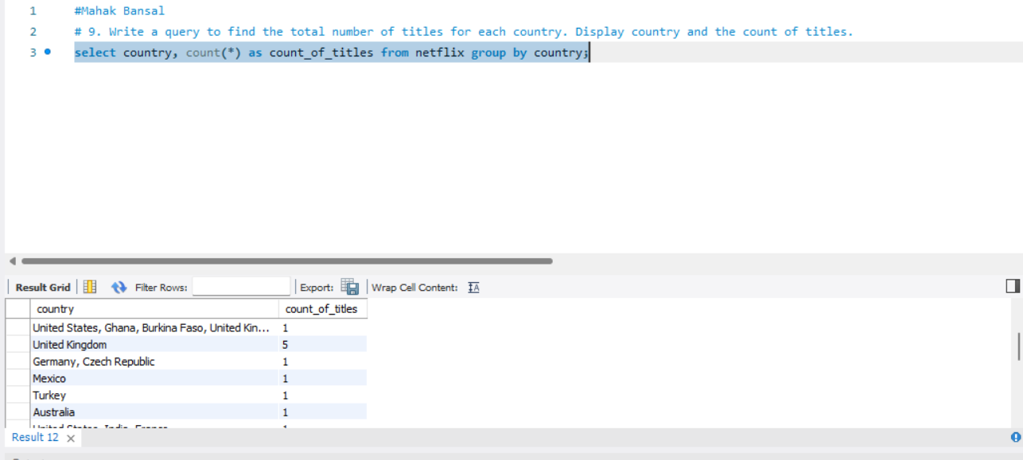
9. Write a query to find the total number of titles for each country. Display country and the count of titles. Query – select country, count(*) as count_of_titles from netflix group by country;

Slide 12
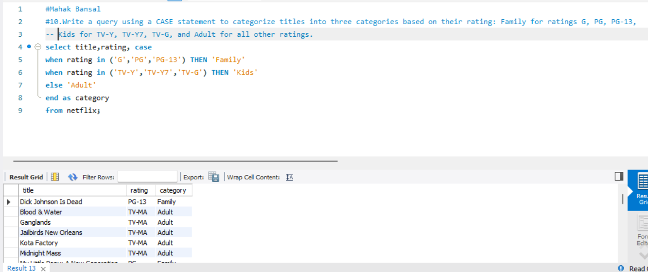
10. Write a query using a CASE statement to categorize titles into three categories based on their rating: Family for ratings G, PG, PG-13, Kids for TV-Y, TV-Y7, TV-G, and Adult for all other ratings. Query – select title, rating, case when rating in ('G','PG','PG-13') THEN 'Family‘ when rating in ('TV-Y','TV-Y7','TV-G') THEN 'Kids' else 'Adult‘ end as category from netflix;

Slide 13
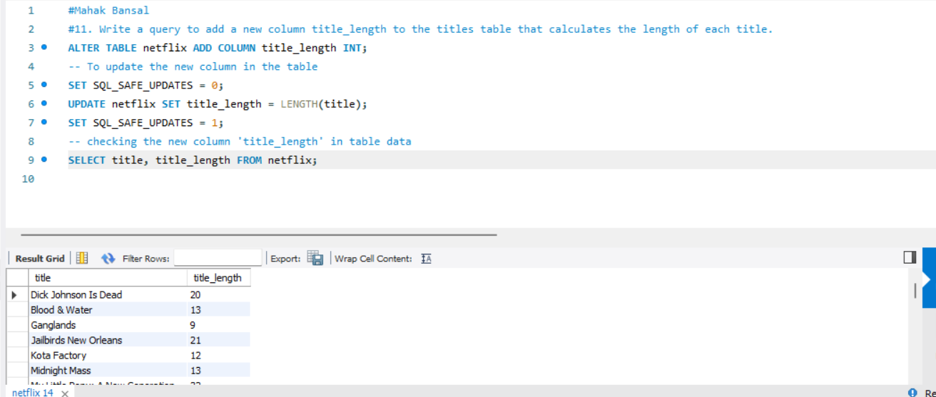
11. Write a query to add a new column title_length to the titles table that calculates the length of each title. Query – ALTER TABLE netflix ADD COLUMN title_length INT;-- To update the new column in the table SET SQL_SAFE_UPDATES = 0;UPDATE netflix SET title_length = LENGTH(title); SET SQL_SAFE_UPDATES = 1;-- checking the new column 'title_length' in table dataSELECT title, title_length FROM netflix;

Slide 14
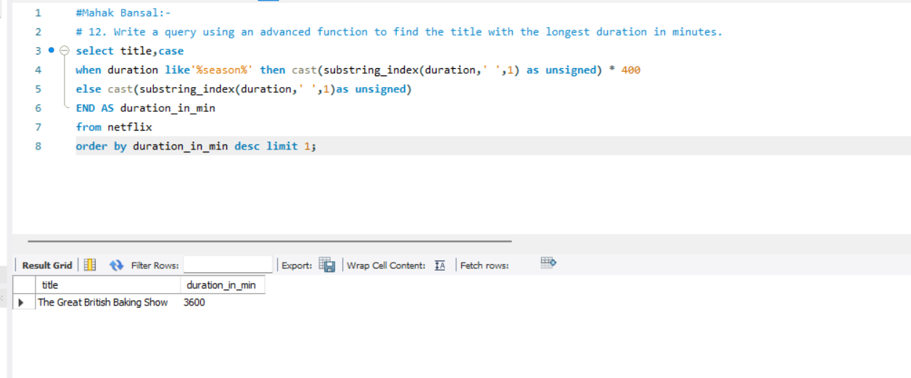
12. Write a query using an advanced function to find the title with the longest duration in minutes. Query – select title,casewhen duration like'%season%' then cast(substring_index(duration,' ',1) as unsigned) * 400else cast(substring_index(duration,' ',1)as unsigned) END AS duration_in_minfrom netflix order by duration_in_min desc limit 1;

Slide 15
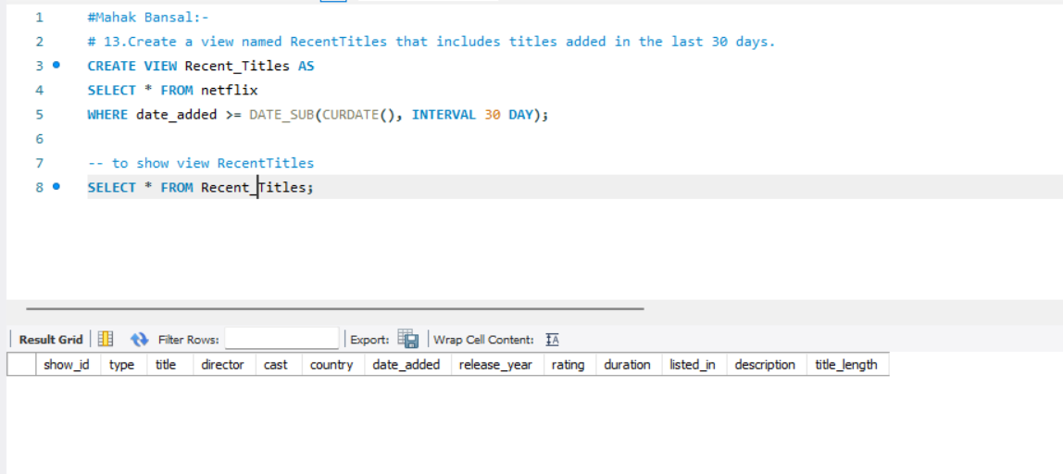
13.Create a view named RecentTitles that includes titles added in the last 30 days. Query- CREATE VIEW Recent_Titles ASSELECT * FROM netflixWHERE date_added >= DATE_SUB(CURDATE(), INTERVAL 30 DAY); SELECT * FROM Recent_Titles;

Slide 16
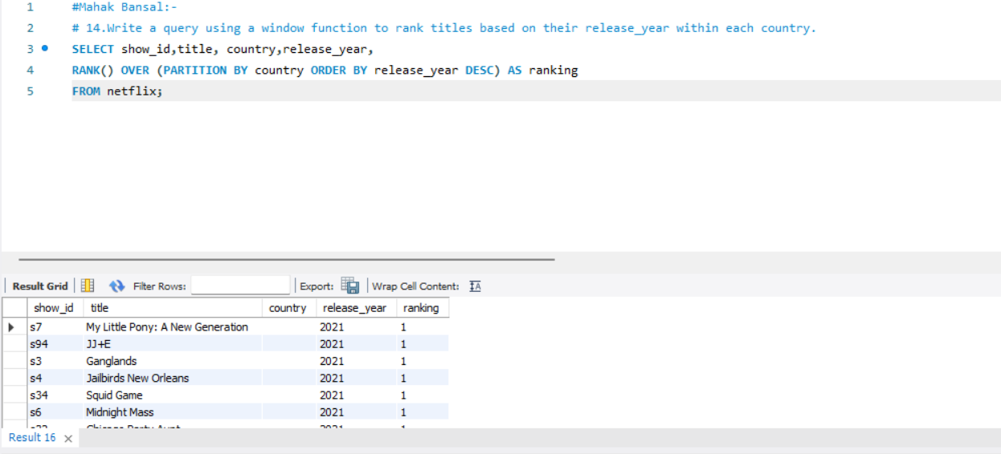
14. Write a query using a window function to rank titles based on their release_year within each country. Query – SELECT show_id,title, country,release_year, RANK() OVER (PARTITION BY country ORDER BY release_year DESC) AS ranking FROM netflix;

Slide 17
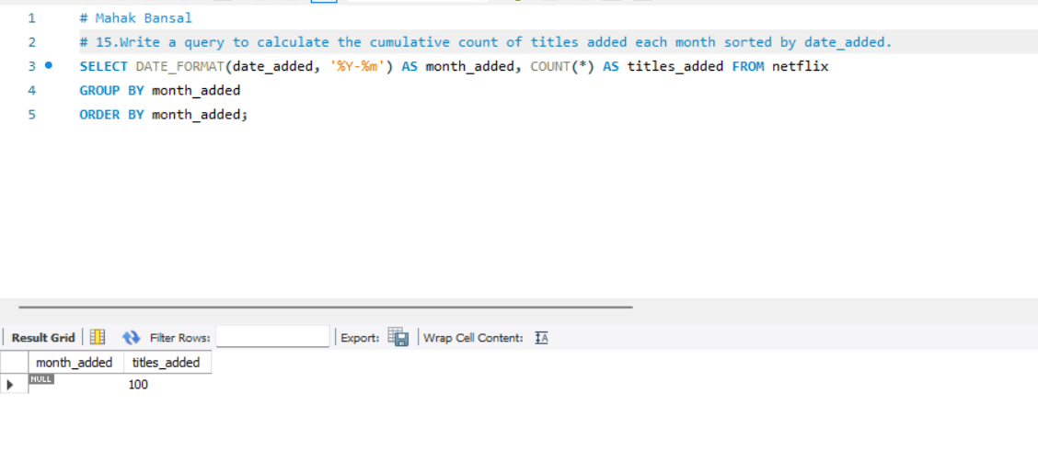
15.Write a query to calculate the cumulative count of titles added each month sorted by date_added. Query – SELECT DATE_FORMAT(date_added, '%Y-%m') AS month_added, COUNT(*) AS titles_added FROM netflixGROUP BY month_addedORDER BY month_added;

Slide 18
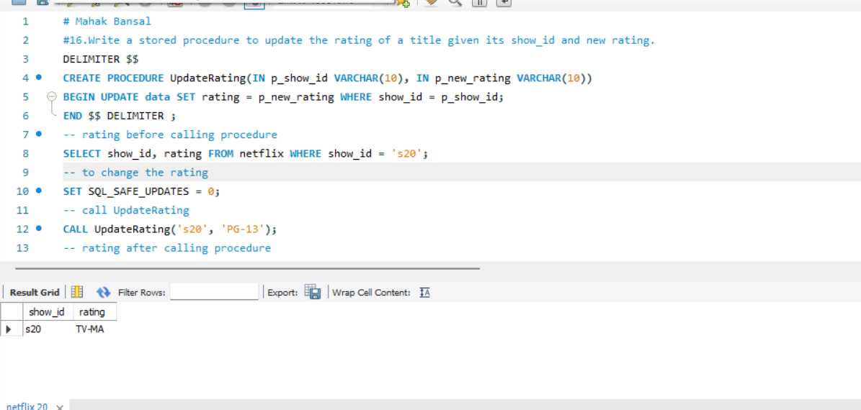
16.Write a stored procedure to update the rating of a title given its show_id and new rating. Query- DELIMITER $$ CREATE PROCEDURE UpdateRating(IN p_show_id VARCHAR(10), IN p_new_rating VARCHAR(10)) BEGIN UPDATE data SET rating = p_new_rating WHERE show_id = p_show_id;END $$ DELIMITER ;SELECT show_id, rating FROM netflix WHERE show_id = 's20';SET SQL_SAFE_UPDATES = 0;CALL UpdateRating('s20', 'PG-13');SELECT show_id, rating FROM netflix WHERE show_id = 's20';SET SQL_SAFE_UPDATES = 1;

Slide 19
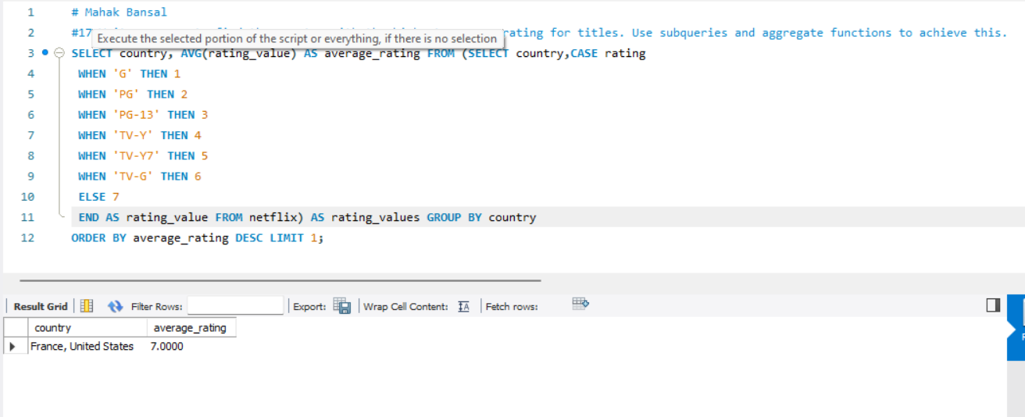
17.Write a query to find the country with the highest average rating for titles. Use subqueries and aggregate functions to achieve this. Query- SELECT country, AVG(rating_value) AS average_rating FROM (SELECT country,CASE rating WHEN 'G' THEN 1 WHEN 'PG' THEN 2 WHEN 'PG-13' THEN 3 WHEN 'TV-Y' THEN 4 WHEN 'TV-Y7' THEN 5 WHEN 'TV-G' THEN 6 ELSE 7 END AS rating_value FROM netflix) AS rating_values GROUP BY countryORDER BY average_rating DESC LIMIT 1;

Slide 20
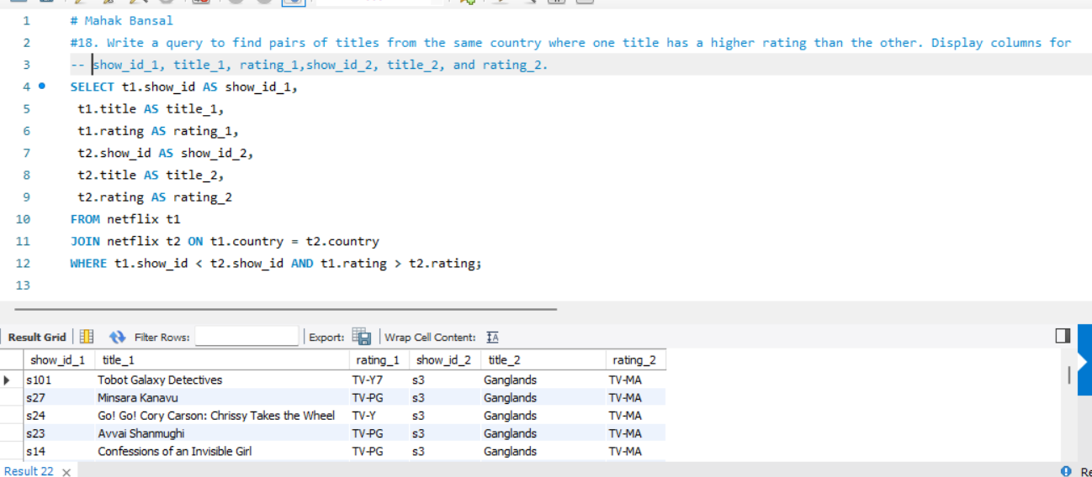
18. Write a query to find pairs of titles from the same country where one title has a higher rating than the other. Display columns for show_id_1, title_1, rating_1,show_id_2, title_2, and rating_2. Query- SELECT t1.show_id AS show_id_1, t1.title AS title_1, t1.rating AS rating_1, t2.show_id AS show_id_2, t2.title AS title_2, t2.rating AS rating_2FROM netflix t1JOIN netflix t2 ON t1.country = t2.countryWHERE t1.show_id < t2.show_id AND t1.rating > t2.rating;

Slide 21


